Slide 1
STA404 Final Project
Collaboration Network Analysis
Group 10
Member 1：Vincent William Hadiasali
Member 2：Lizhuo Luo

Slide 2

0
Background
Arxiv HEP-PH (High Energy Physics - Phenomenology) collaboration network is from the e-print arXiv and covers scientific collaborations between authors papers submitted to High Energy Physics - Phenomenology category. If an author i co-authored a paper with author j, the graph contains a undirected edge from i to j. If the paper is co-authored by k authors this generates a completely connected (sub)graph on k nodes.

Slide 3
1
Basic Statistics
2
Structures
目
录
3
Deep exploration
4
Conclusion

Slide 4
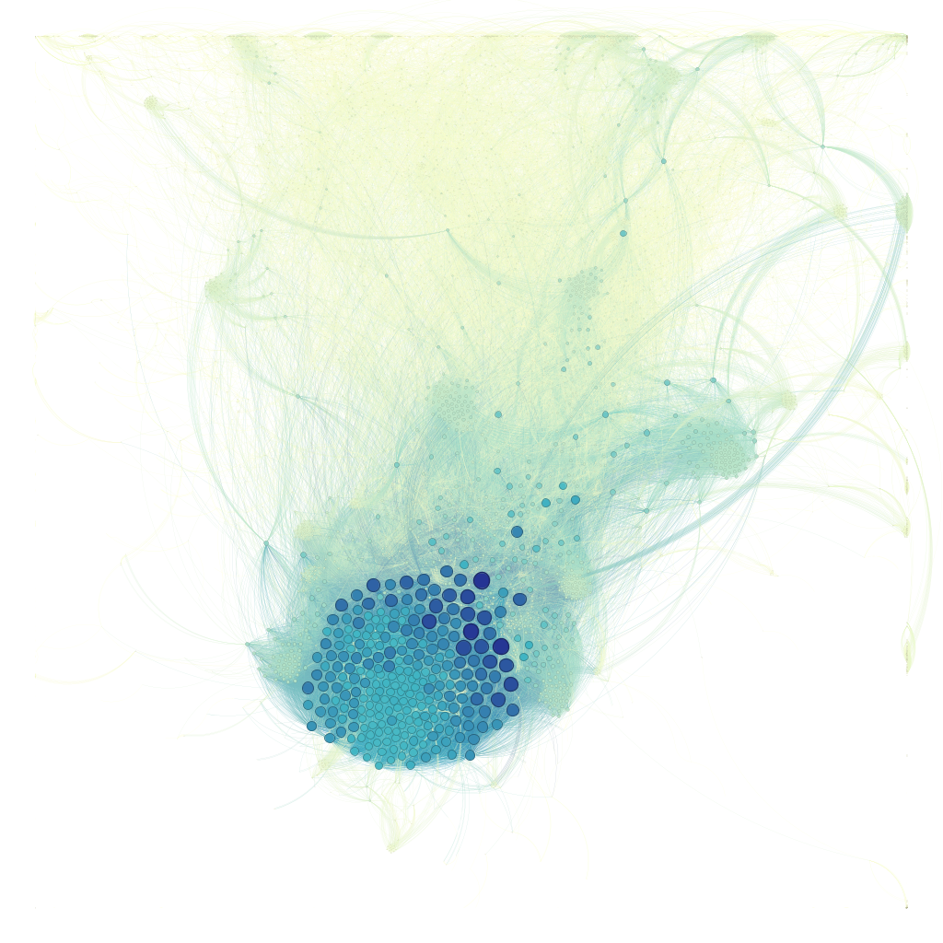
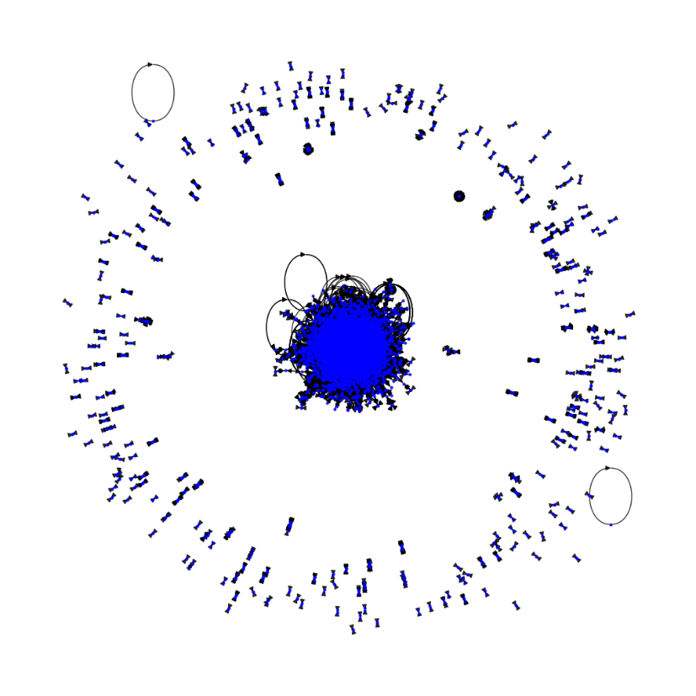
1
Basic Statistics
What does our network look like?

Slide 5
1
Basic Statistics
Network appearance, number of nodes, number of links, average degree, Shortest path lengths, Diameter.

Slide 6
1
Basic Statistics
Number of nodes: 12,008
Number of links: 118,521
Hubs: we choose hubs as 482, 486, 491
Average degree: 19.740339773484344
Average Distance (Largest Component): 4.67
Diameter (Largest Component): 13

Slide 7
2
Structures
Connectedness, Component, Degree Distribution, Clustering

Slide 8
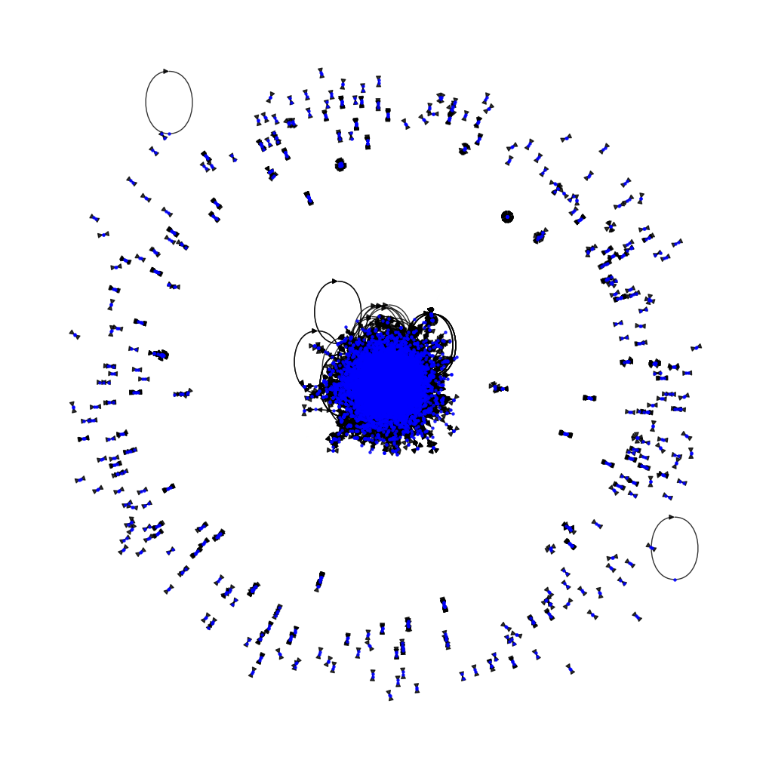
2
Structures
Connectedness
Number of connected components: 276.
Number of nodes in the giant component: 11,204.

Slide 9
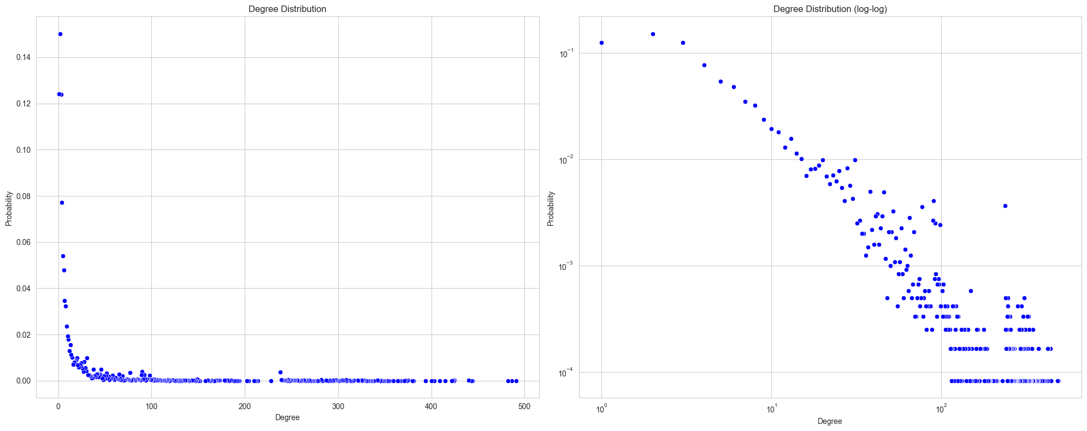
2
Structures
Degree Correlation
491

Slide 10
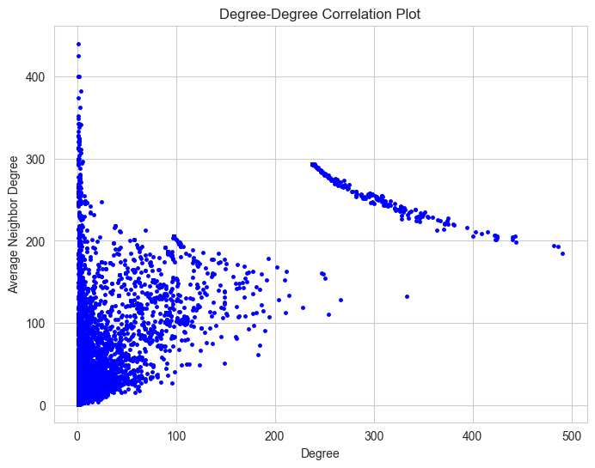
2
Structures
Degree-Degree Correlation Plot
The average assortativity coefficient is 0.632 indicating assortative.
But in the plot, as the degree goes bigger, the average neighbor degree goes smaller.
It is ‘Mixed’!

Slide 11
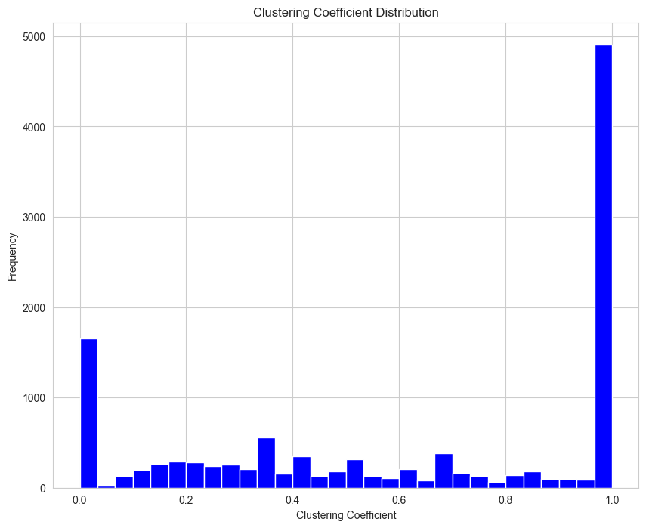
2
Structures
Clustering Coefficient
The average clustering coefficient: 0.611.
Consistent with complete graph

Slide 12
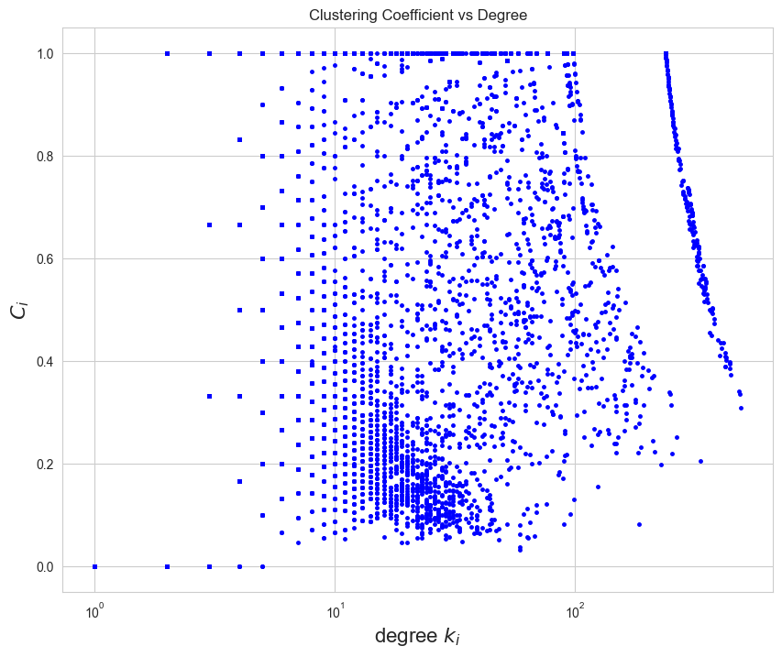
2
Structures
Clustering Coefficient v.s. Degree
Nodes with low degrees (on the left side of the plot) exhibit a wide range of clustering coefficients, from 0 to 1.
Nodes with high degrees (on the right side of the plot) tend to have lower clustering coefficients, often clustering around lower values.
Hierarchical Structure.
Small-World Nature.
Disassortative.

Slide 13
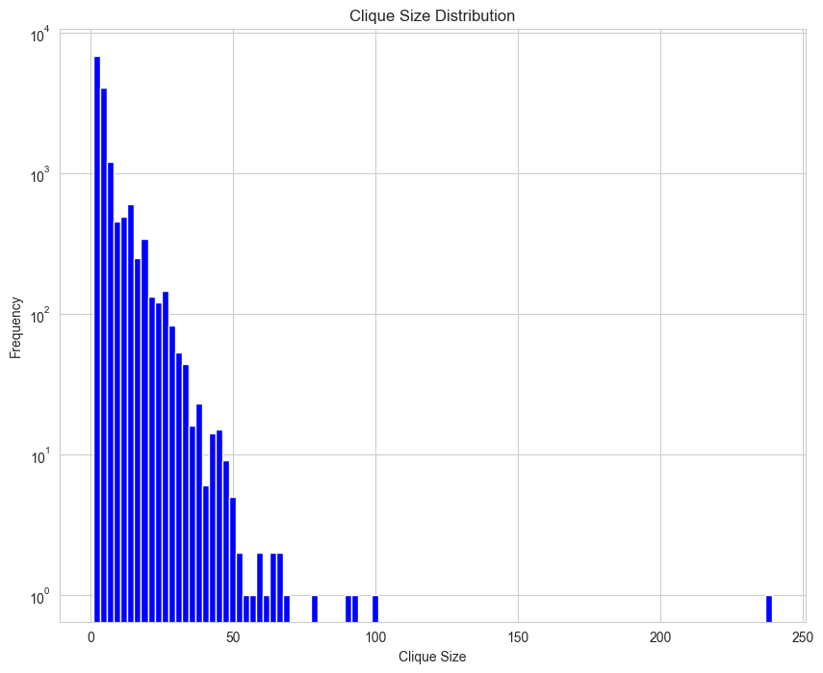
2
Structures
Clique Size Distribution
Due to lots of complete subgraph in the network, we start an exploration of cliques.
There are 8093 cliques with size larger than 3
Average clique size is 6.168819867461008

Slide 14
3
Deep Exploration topics
Community detection, Simulation and Prediction.

Slide 15
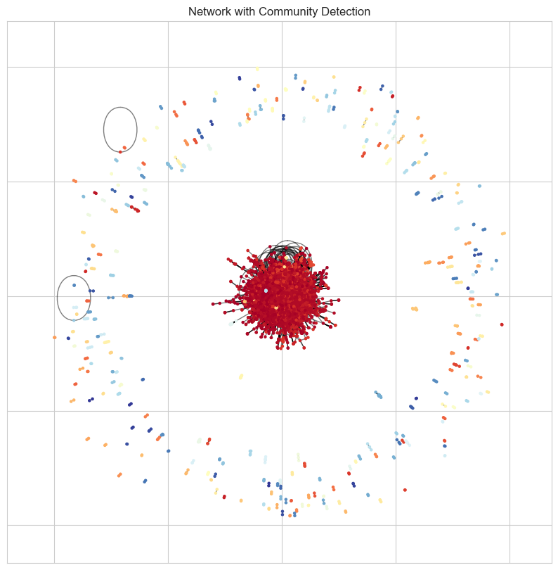
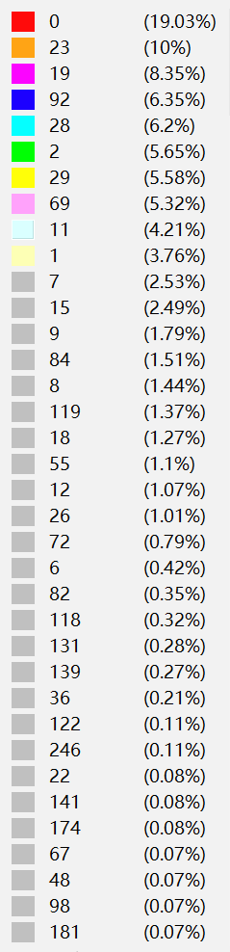
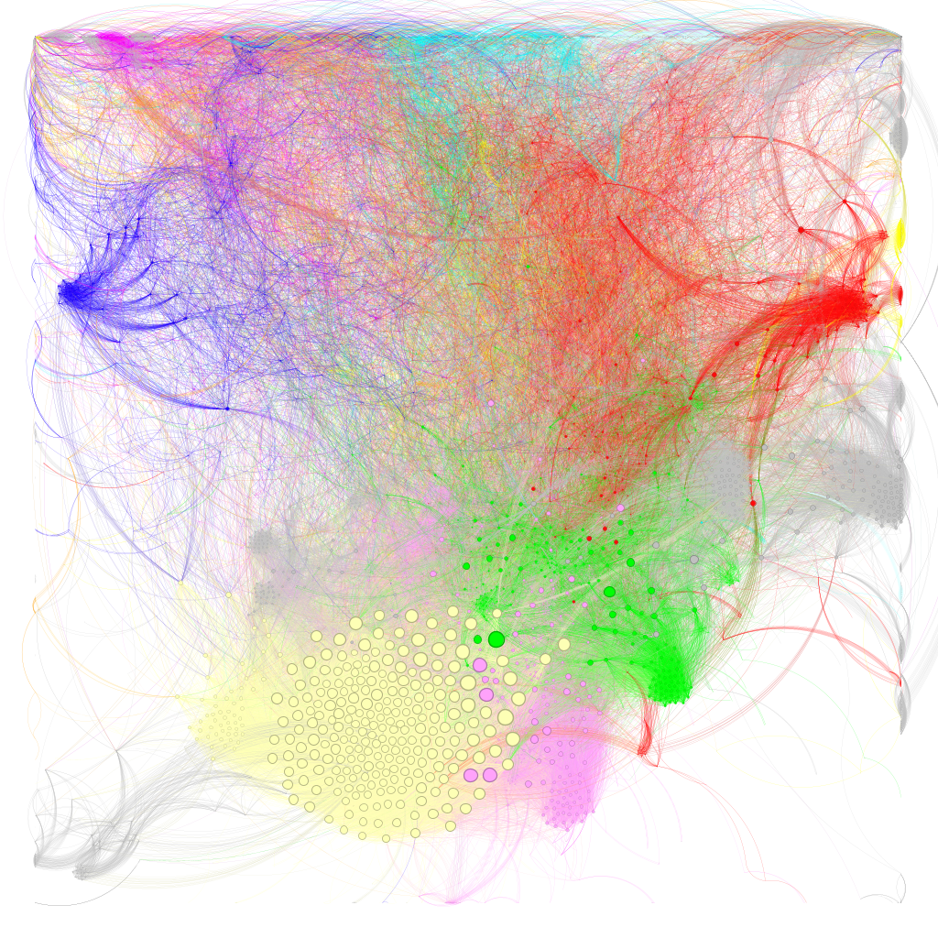
3
Community Detection
Modularity of GL : 0.6616035051425436

Slide 16
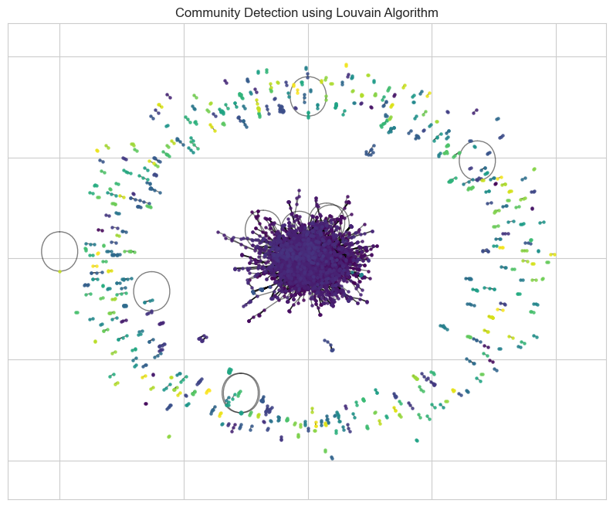
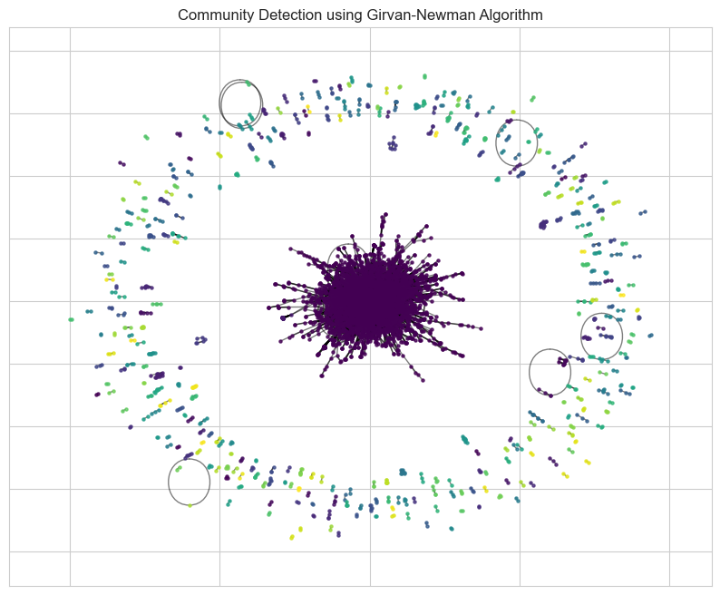
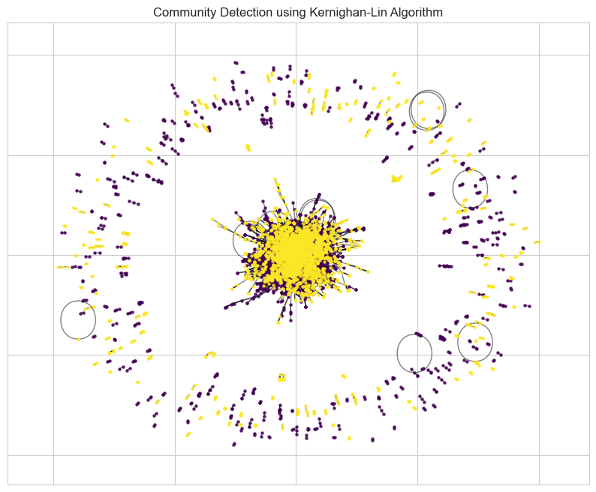
3
Community Detection

Slide 17
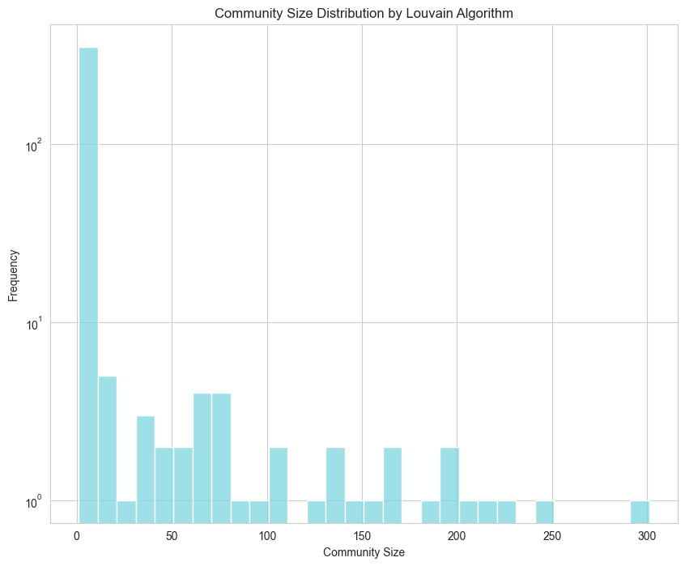
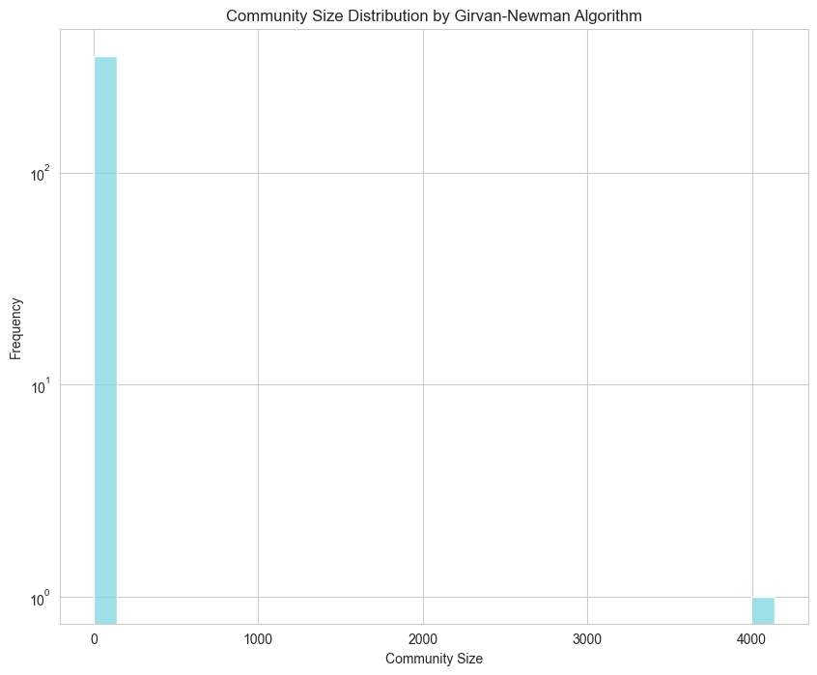
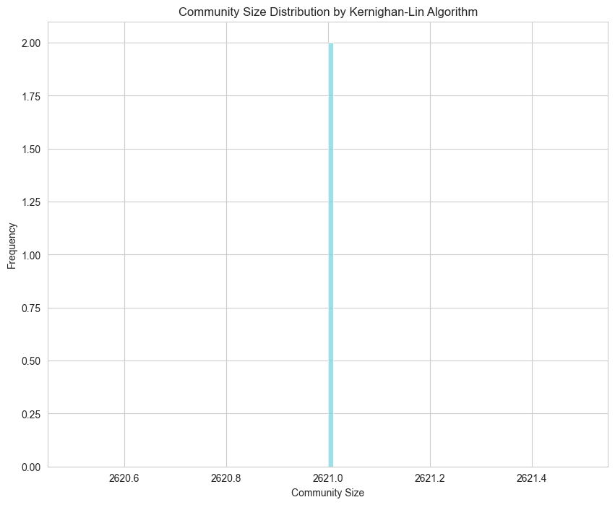
3
Community Detection

Slide 18
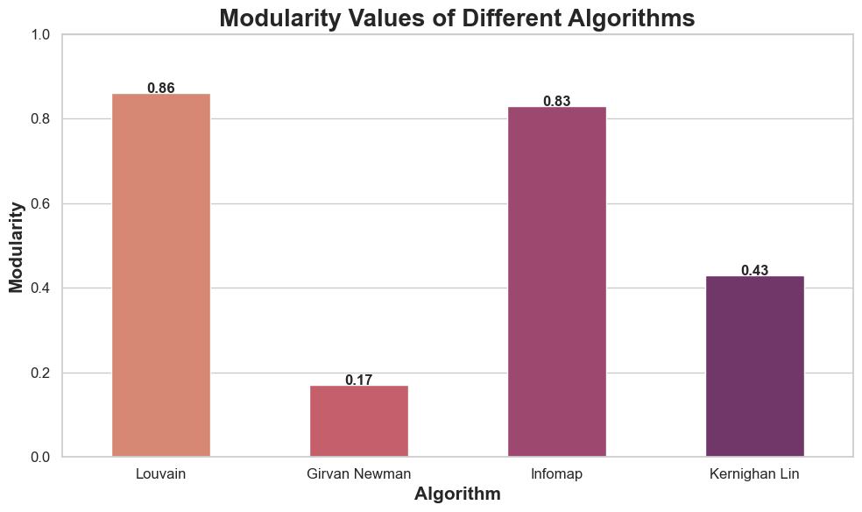
3
Community Detection

Slide 19
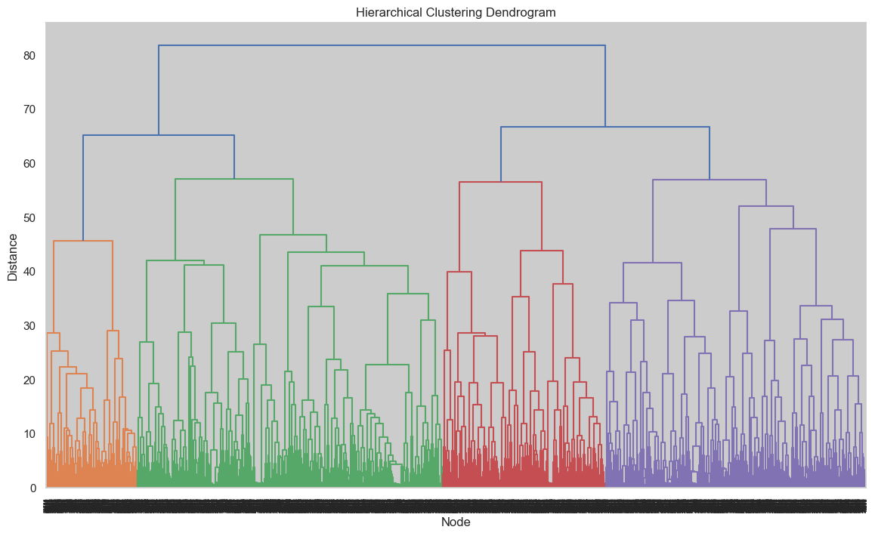
3
Hierarchical Structure

Slide 20
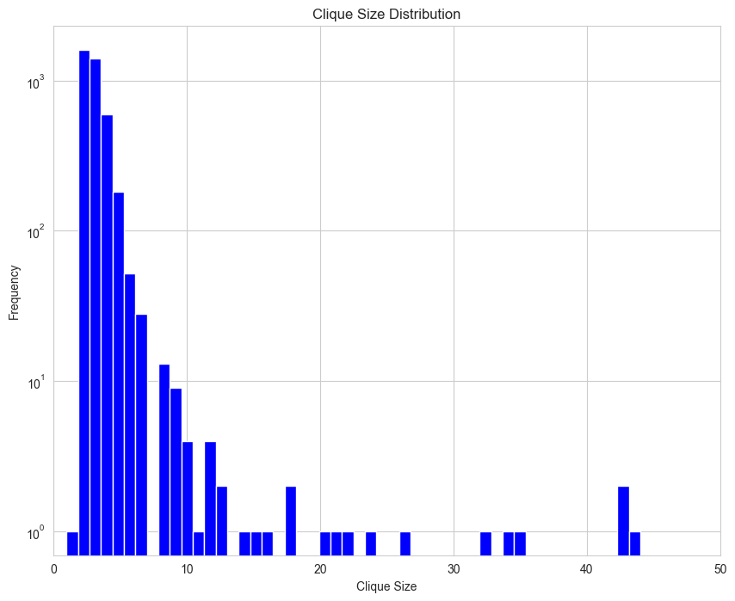
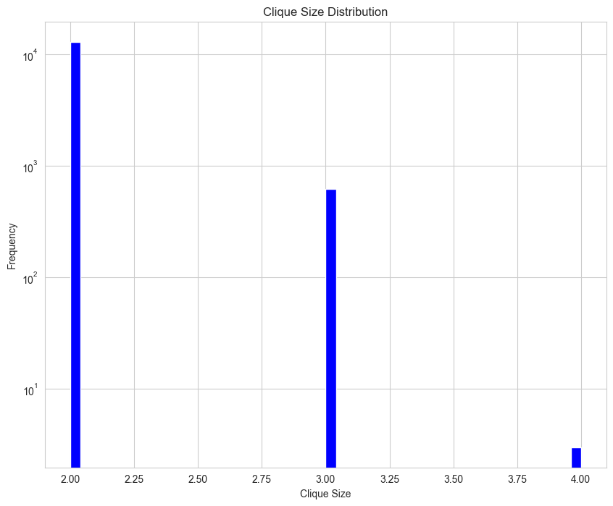
3
Null Model

Slide 21
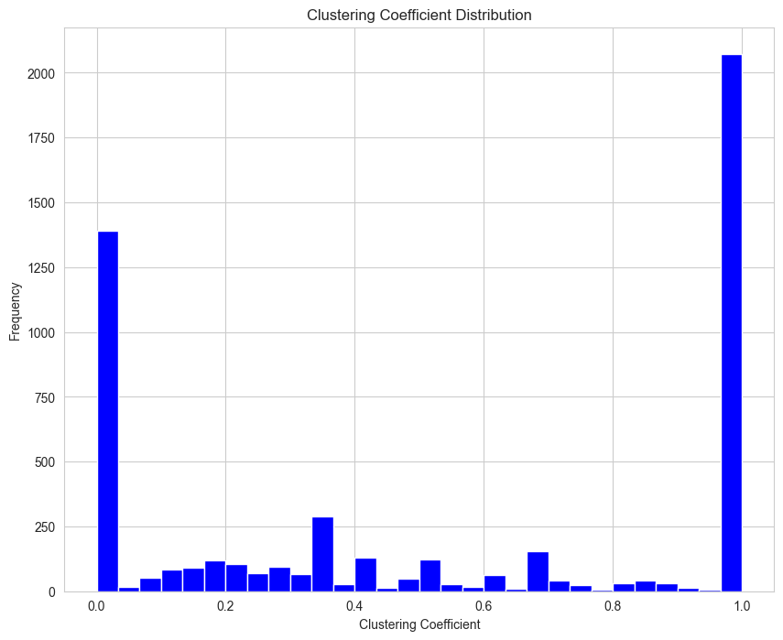
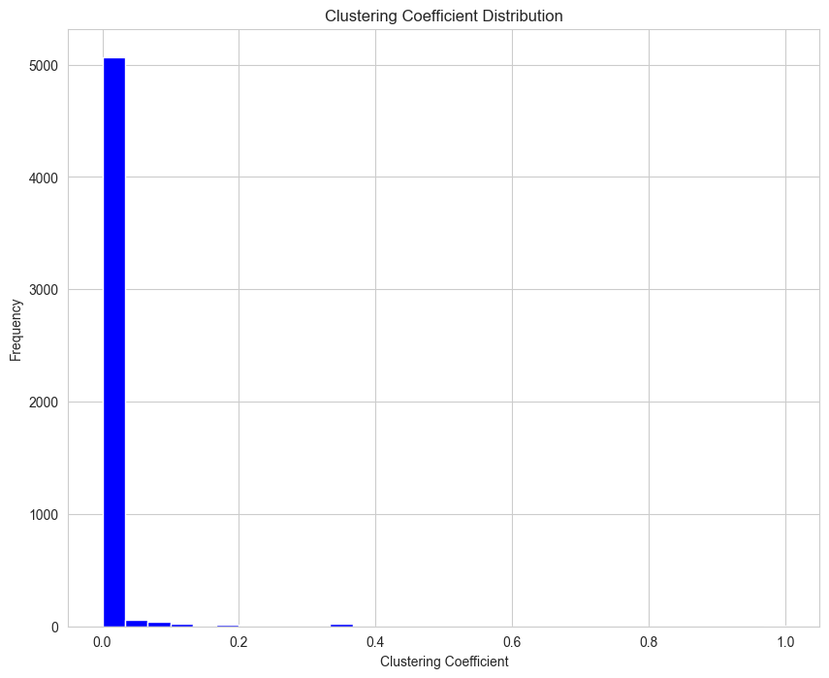
3
Null Model

Slide 22
3
Simulation Process
Simulation Process
Check no duplicate edges .
Define the Author activity by the num of paper he published estimated by (Degree / AVG Degree).
Define the connection strength by the num of collaboration between to authors initialed by 1.
Chose authors randomly and update their Author activity based on their current activity.
Chose edges randomly and update their connection strength based proportion to strength.
remove some nodes and edges temporarily in random. Any pair of coauthor will not contact for some time.
After iterations, fit a linear model to predict future.

Slide 23
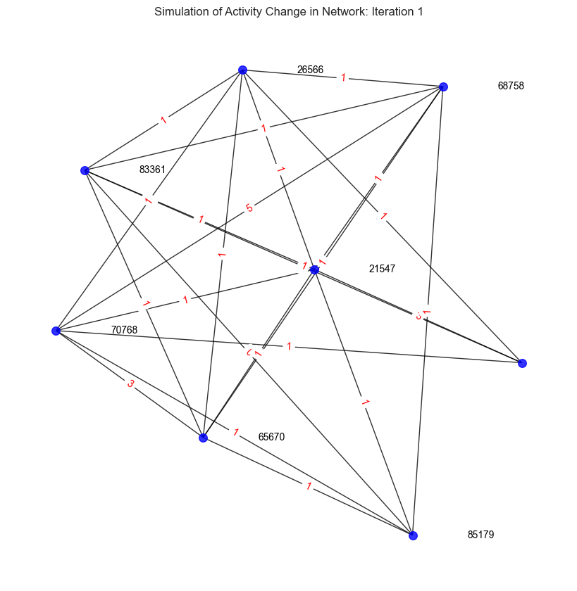
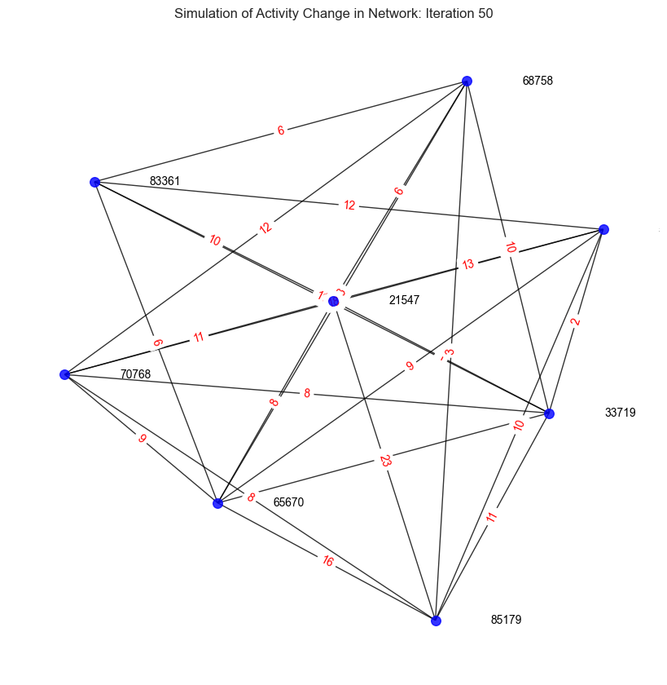
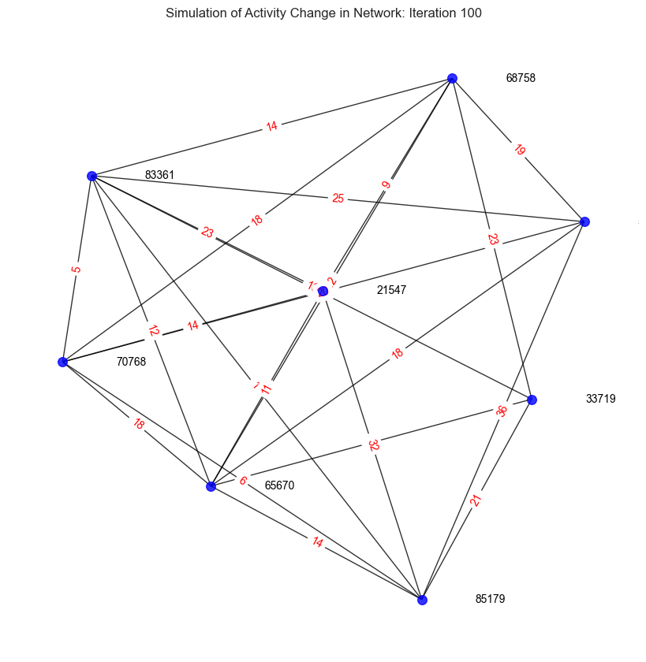
3
Simulation Process
Simulation Process

Slide 24
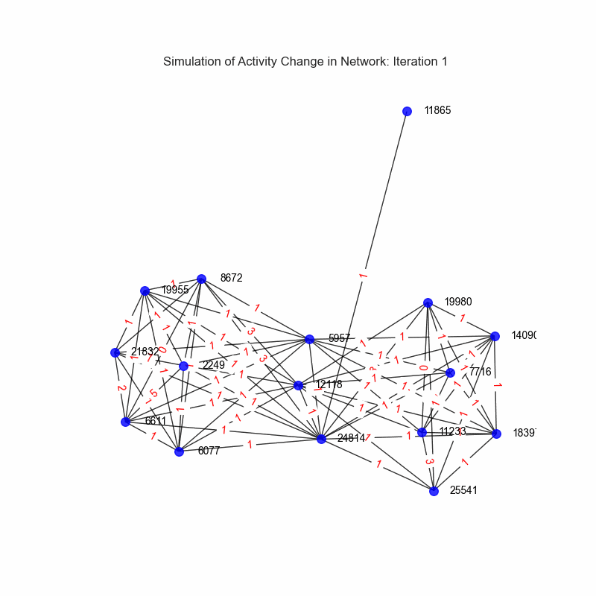
3
Simulation Process

Slide 25
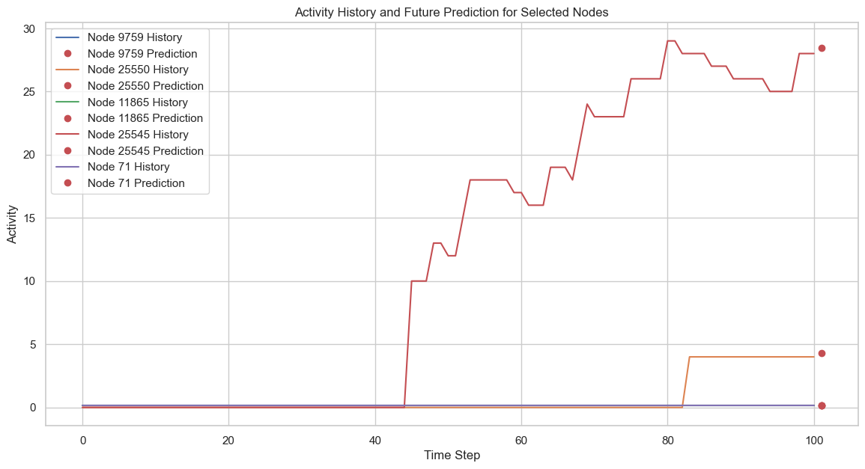
3
Prediction

Slide 26
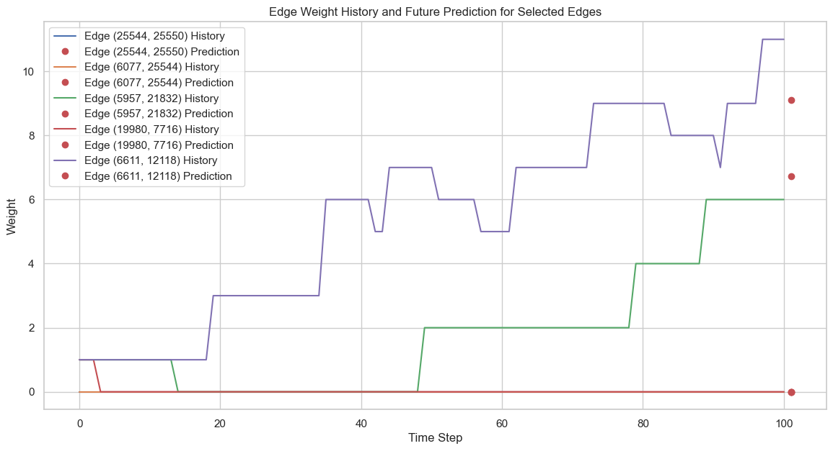
3
Prediction

Slide 27
4
Conclusion
To sum everything up…

Slide 28
4
To sum everything up
The network is nearly a scale free network. The degree distribution almost follows power law.
It is nearly both assortative and disassortative, It is ‘mixed’
Due to the properties of collaboration, there are lots of cliques in the graph, leading to a dense network
There are lots of typical community in the network, and the GL algorithm have a better partition than Greedy algorithm.
The simulation part show that the collaboration strength goes larger as time goes and authors published more papers with different speed.

Slide 29
4
Future Works
Improve the simulation system, can get more parameters by statistic.
Apply more complex model, such as GLM, Random Forest, Neural Network to improve the reliability of our model.

Slide 30

Thank you!

